Slide 1
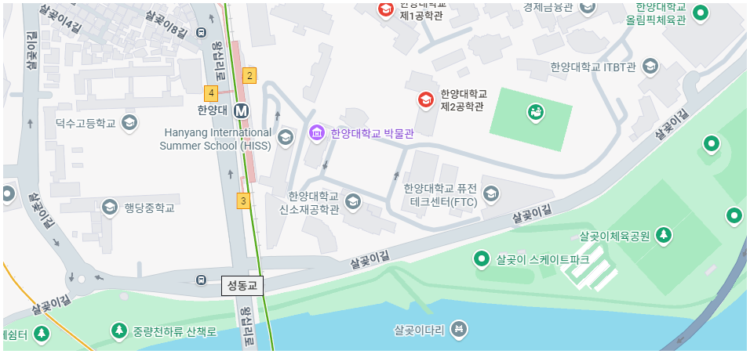



[Contact]
Welcome!
Professor office
Address: Room no. 301, Advanced Materials and Chemical Engineering Building, Department of Chemical Engineering, Hanyang University, 222 Wangsimni-ro, Seongdong-gu, Seoul, Republic of Korea.
Email: kiho138@hanyang.ac.kr
Tel.: +82-2-2220-0523
Graduate Lab
Address: Room no. 313/314, Advanced Materials and Chemical Engineering Building, Department of Chemical Engineering, Hanyang University, 222 Wangsimni-ro, Seongdong-gu, Seoul, Republic of Korea.
대표 mail: 어쩌구
Arial
[우리 연구실로 오세요!]
우리는 어떤 걸 하고
어떤 사람들을 사람을 모집하고 있다
상담 환영한다
Contact 기다리겠다
글꼴
글꼴
글꼴
Direct links

